Slide 1
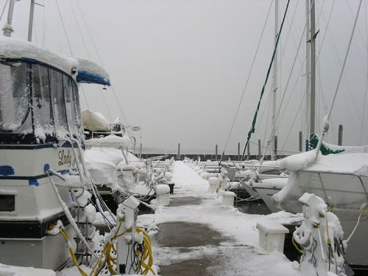
Winterization Overview
Northern Virginia Sail and Power Squadron
November 2012

Slide 2
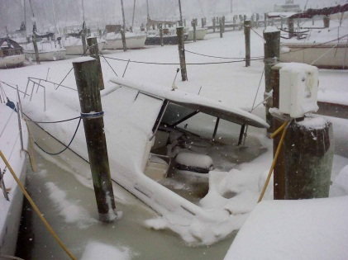
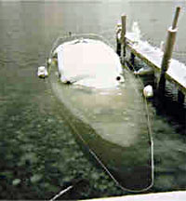
Why Winterize?
Your boat is a significant investment that needs to be protected
Prevention is always cheaper than repair
Virginia winters are capable of below zero temperatures for more than 72 hours
States with the most winter-caused losses
California,
Florida,
Texas,

Slide 3
Getting Started
Review your boat’s manuals
Manufacturer’s operations manuals
Engine/Generator manuals
Systems manuals
Hull care and maintenance
Mechanical systems
Plumbing systems
Air-conditioning systems
Appliances
Electrical/Electronics
Collect winterization and spring commissioning checklists
Manufacturers (boat, engines, systems, etc.)
Internet (boating articles, sample checklists, etc.)
Marina service department
Power Squadron members
Boating friends

Slide 4
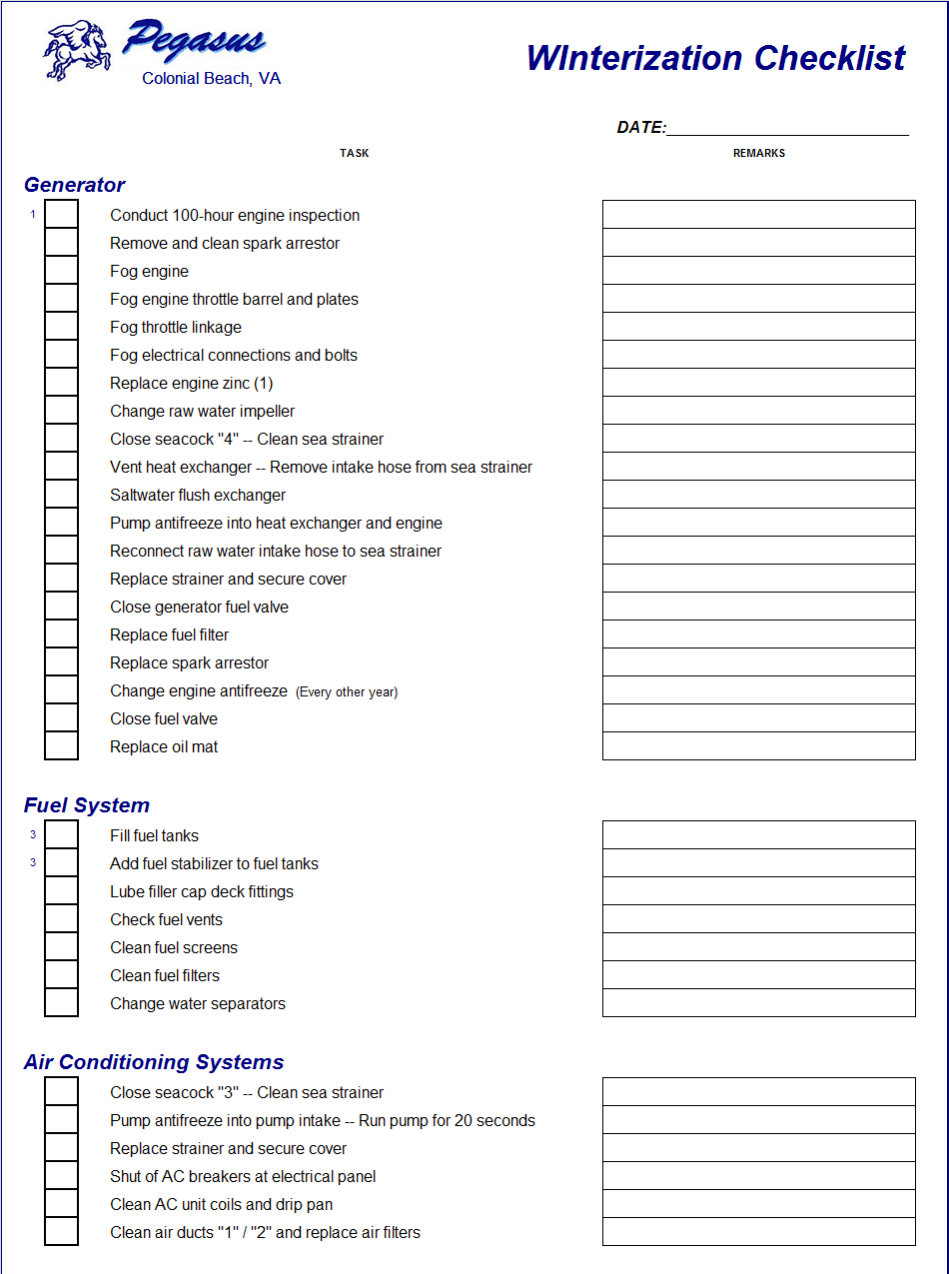
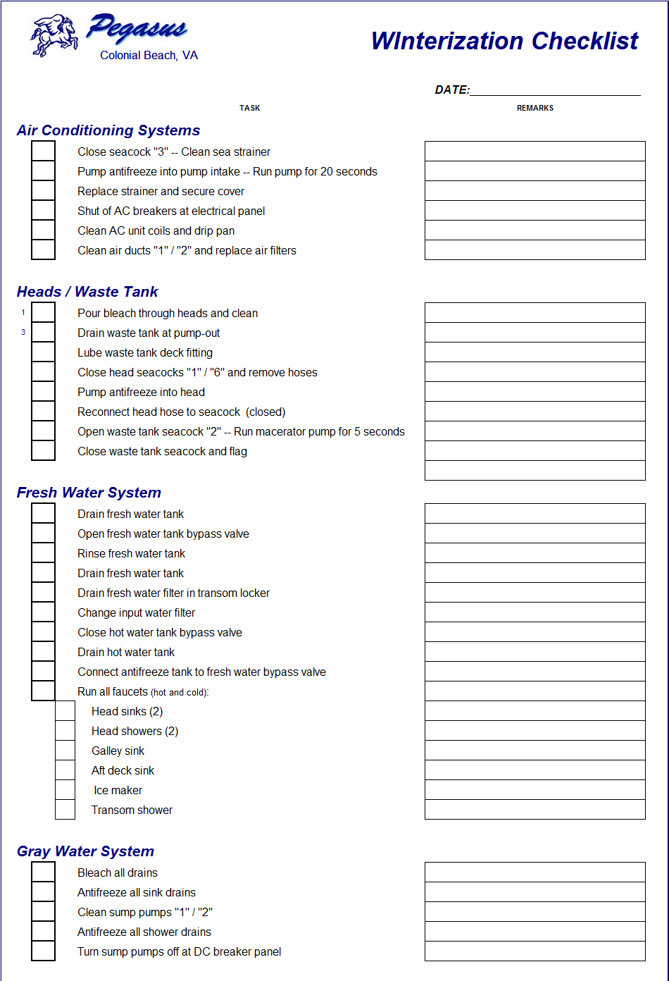
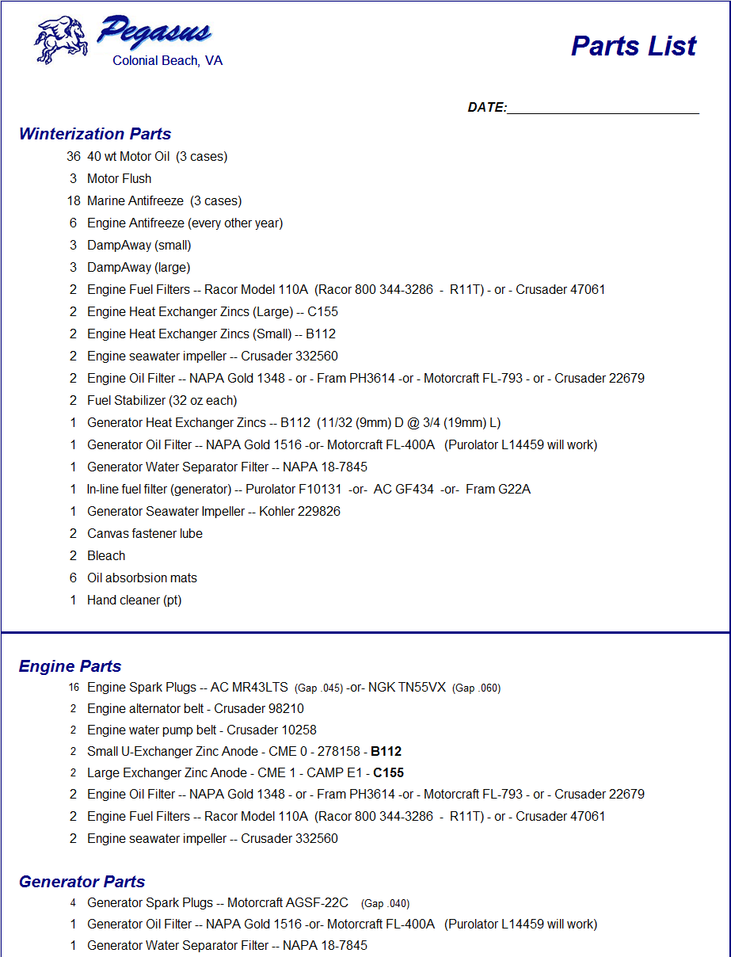
Getting Started (Continued)
Build your own checklist
Specific to the needs of your boat
Logical order of steps
The more detailed the better
Include sub-steps and/or notes
Create a list of supplies and parts you are going to need
Engine oil / Lubricants
Antifreeze
Fogging oil
Filters (fuel / oil / water / water separator)
Impellers
Zincs
Fuel stabilizer / biocide
Cleaning supplies / oil mats

Slide 5
Money Saving Tips
Buy fuel/oil filters, water separators, motor oil and miscellaneous supplies from a local auto parts store
Buy your boat winterizing supplies early (antifreeze, stabilizers, zincs, etc)
Use -50° antifreeze for all water systems, but use -100° antifreeze for the enhanced corrosion protection for the engines
Carefully remove and save your old impellers as spares

Slide 6
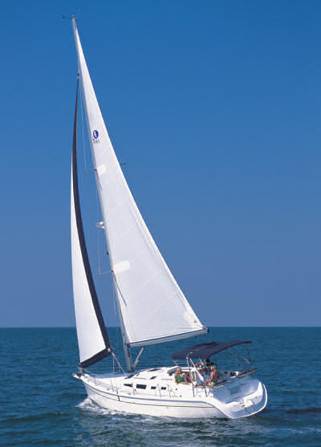
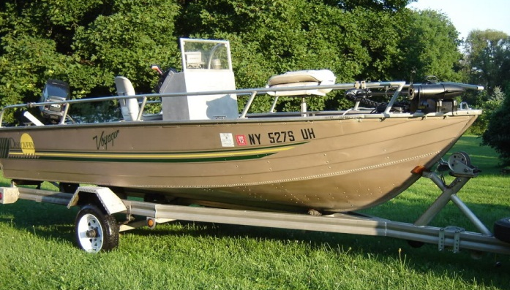
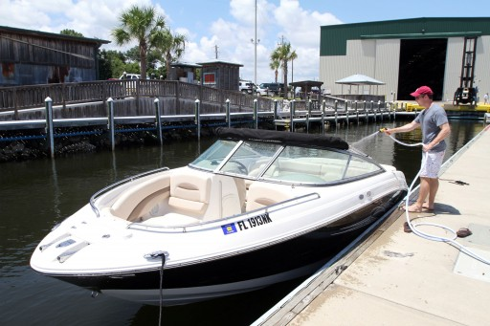
Types of Winterizing
Type of drive system
Outboard
Inboard / Outboard (I/O)
Inboard
Sail drive
Jet drive
Sail
Storage
On land
On water
On the trailer
Other items
Dinghy
Trailer

Slide 7
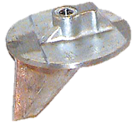
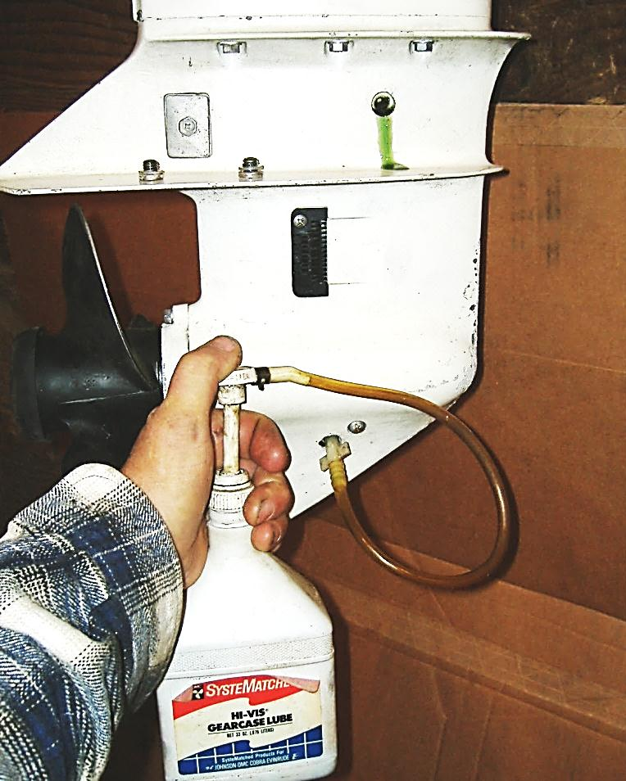
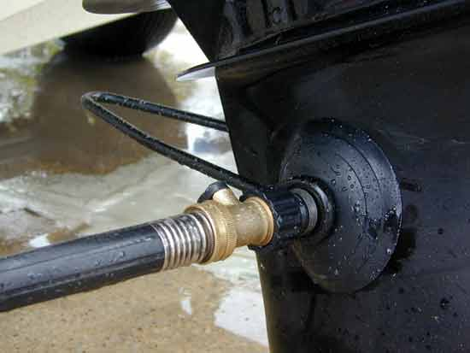
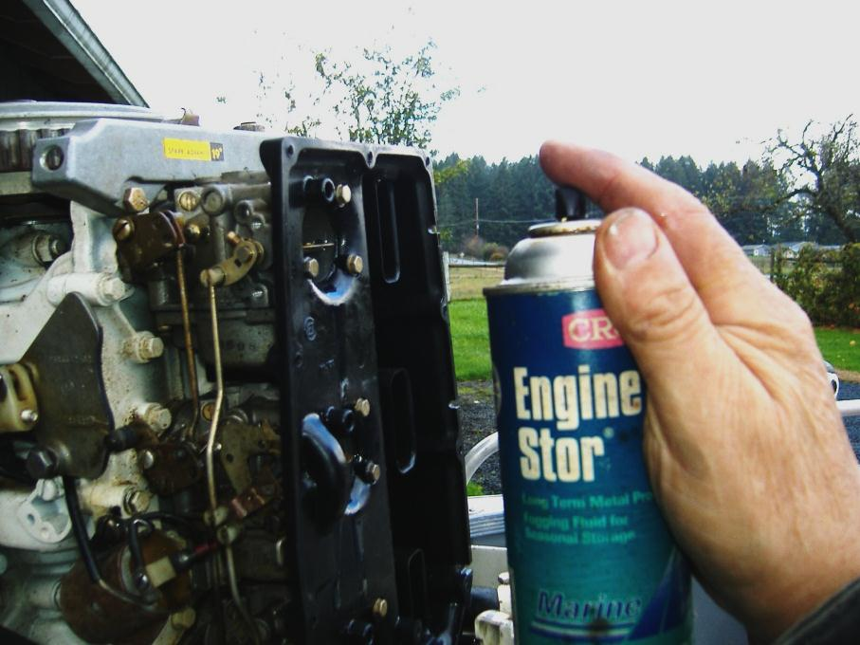
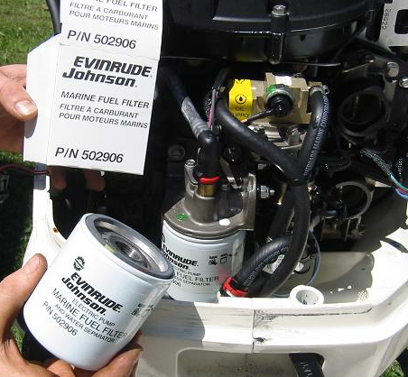
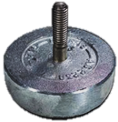
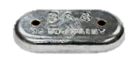
Outboard Motor Winterization
Conduct 100-hour engine inspection
Rust and corrosion
Wire chafing
Change fuel filter – Flush fuel lines and carburetor
Change oil and filter (4-stroke engines)
Change air filter (if equipped)
Flush engine block
Fog engine and mechanical linkages
(throttle linkage, shift cables)
Lubricate lower unit
Change engine / drive unit zincs

Slide 8
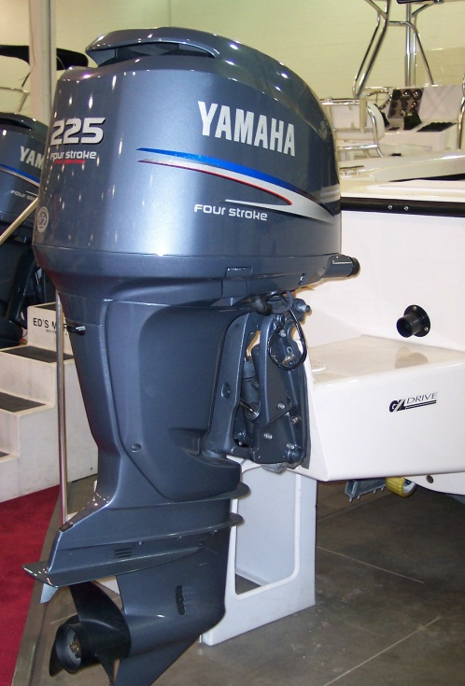
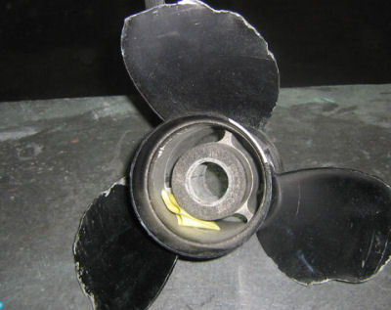
Outboard Engine Winterizing
Inspect U-joint bellows and bellow hose clamps for wear or weathering
Place drive in the DOWN position
Clear water drain holes in drive unit
Pitot tube
Trim cavity vent and cavity drain
Gear housing water drain and cavity vent, and drain holes
Clean drive surfaces and repaint bare metal
Coat drive with a corrosion inhibitor
Inspect prop

Slide 9
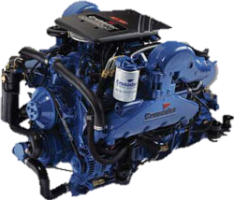
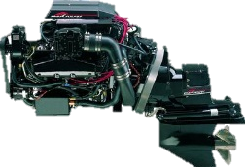
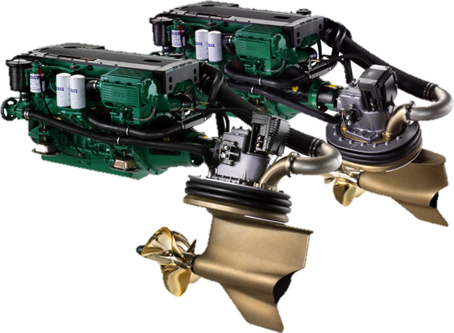
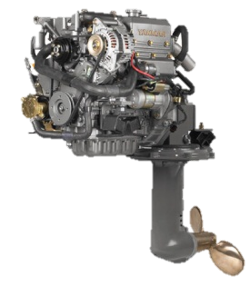
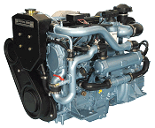
Engine Winterization
Conduct 100-hour engine inspection (per manufacturer’s spec)
Rust and corrosion
Worn belts/hoses
Exhaust muffler and tubes
Wire chafing
Fuel system (Schrader valve, in-line screens/filters)
Engine servicing
Oil and filter change
Inspect/clean spark arrestor (if equipped)
Fog engine and mechanical linkage (throttle, shift cables)
Antifreeze heat exchanger or engine block
Change engine zincs
Seacocks / Sea strainers
Biannual maintenance (as directed by manufacturer)
Change raw water impeller
Change transmission fluid
Change engine antifreeze

Slide 10
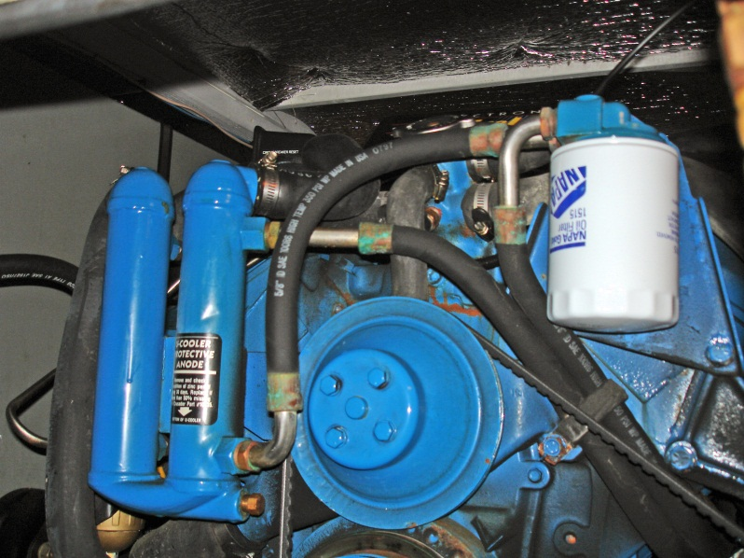
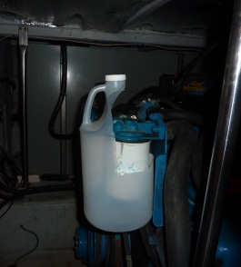
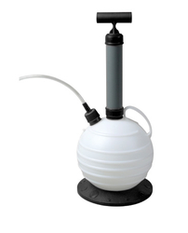
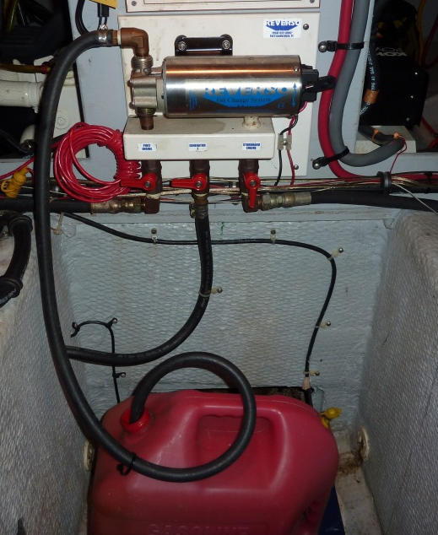
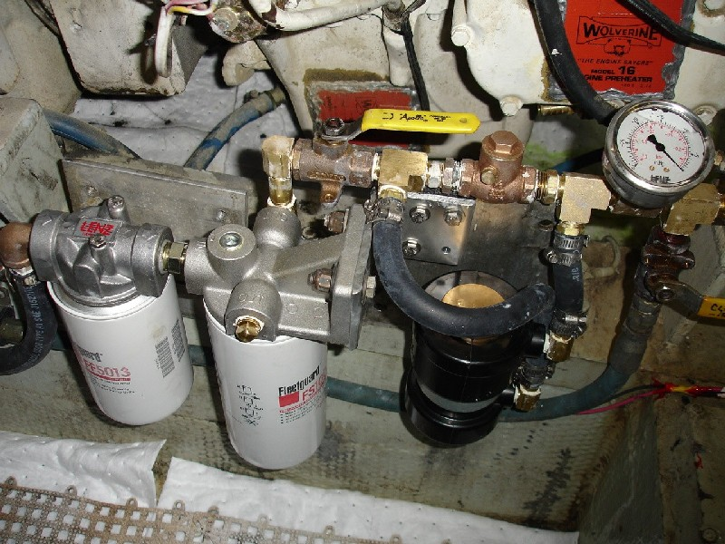
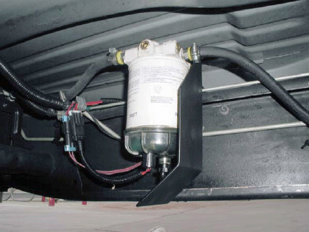
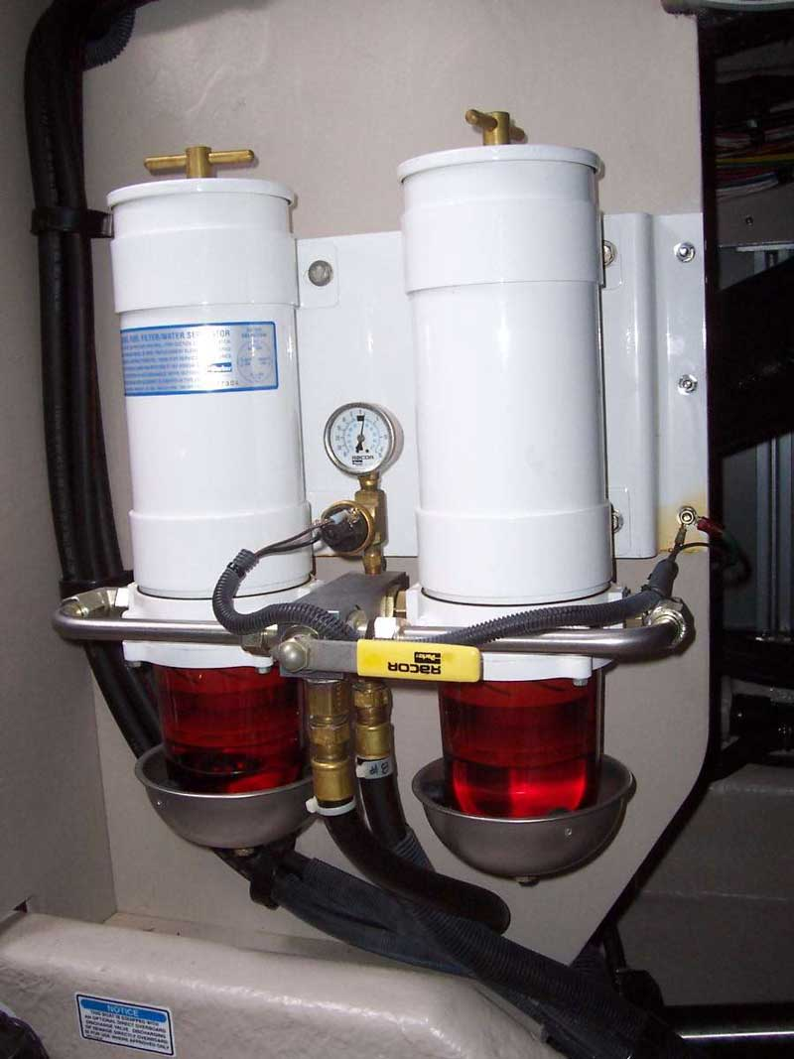
Oil / Filter Change
Old oil has contaminates that will act on engine components during the winter
Check oil lines to the U-Cooler
Tip: a plastic bottle can be used to keep oil from spilling into the bilge
Northern Virginia Sail & Power Squadron ®

Slide 11
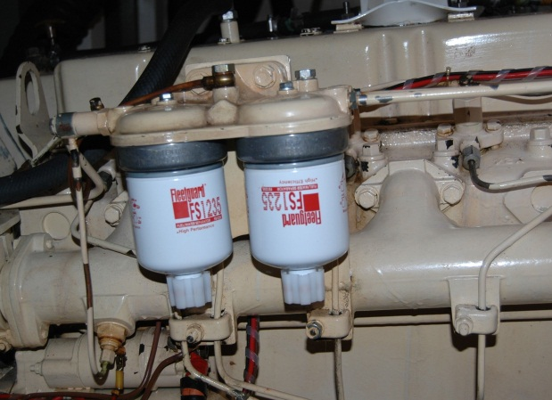
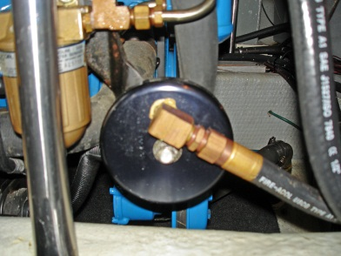
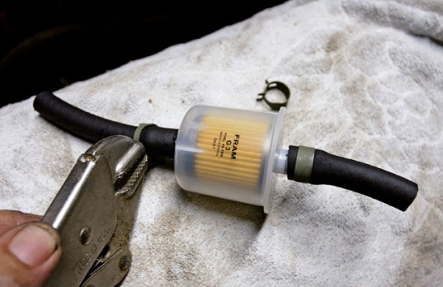
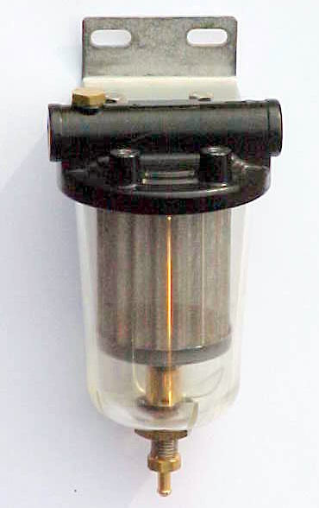
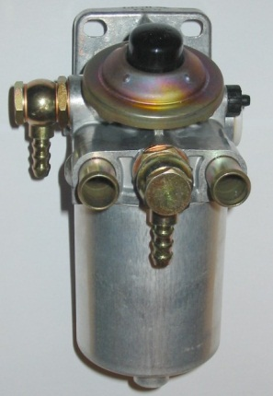
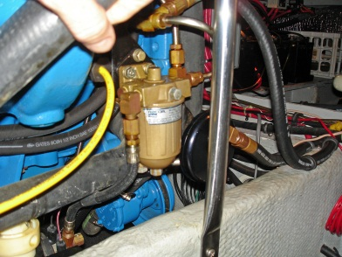
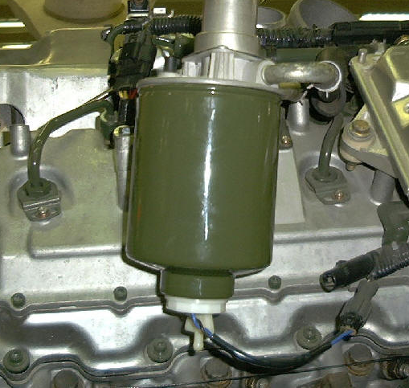
Fuel System
If you fill fuel tanks, add stabilizer
Lube filler cap deck fittings
Check fuel vents
Clean fuel tank filters
Change water separators
Close engine fuel valves -- Clean fuel strainer
Replace fuel filter

Slide 12
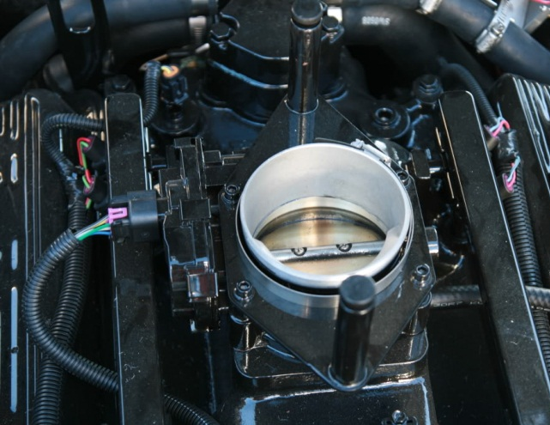
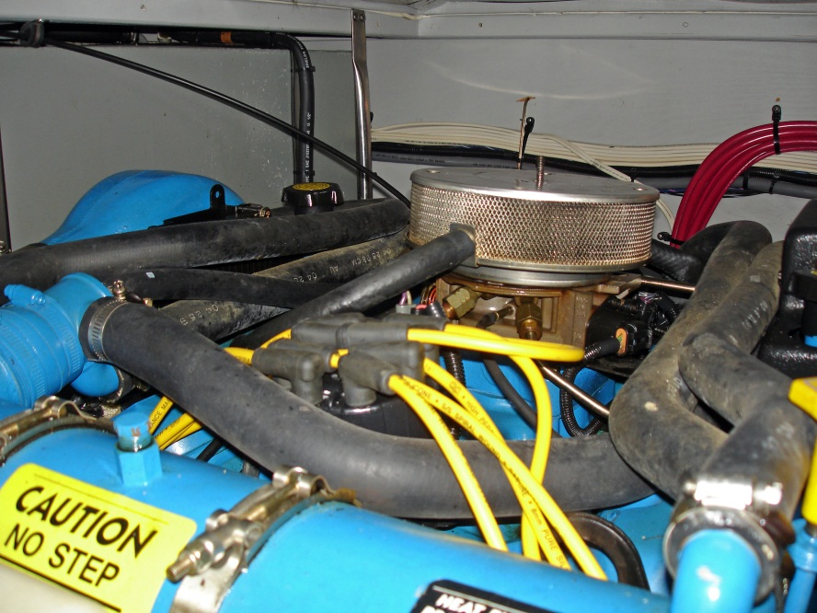
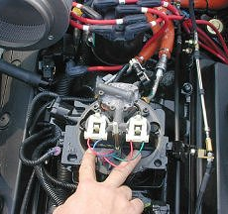
Engine Fogging
Clean and inspect Spark Arrester
Fog manifold/injector intakes and throttle/shift linkage

Slide 13
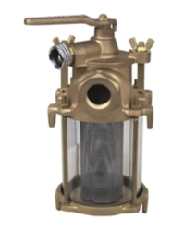
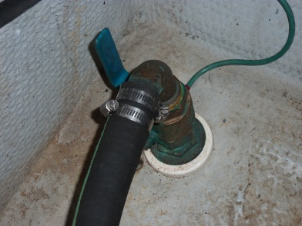
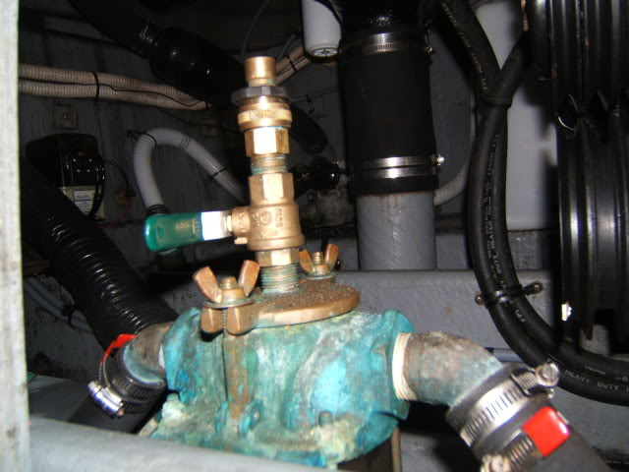
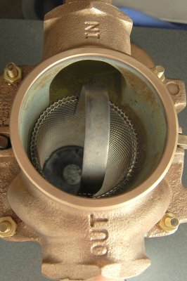
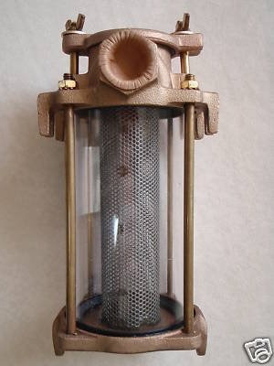
Sea Strainers and Sea Cocks
Sea strainers should be cleaned and filled with antifreeze
Sea cocks need to be closed
Flush valves make winterizing engines easier and more thorough

Slide 14
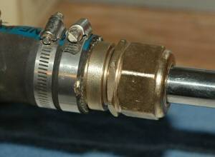
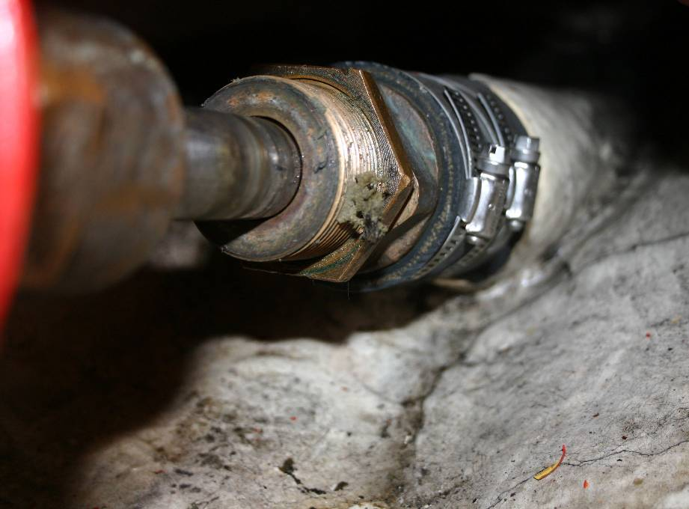
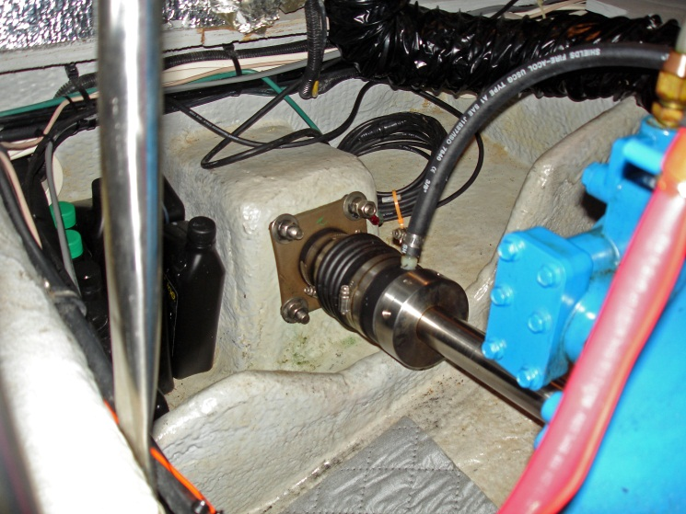
Stuffing Boxes and Dripless Shafts
Check stuffing box drip rate
Make sure it is not dripping when stopped
2-3 drop per minute when running is ideal
Check that dripless shafts are not dripping at all

Slide 15
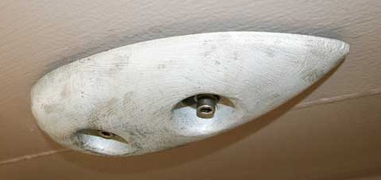
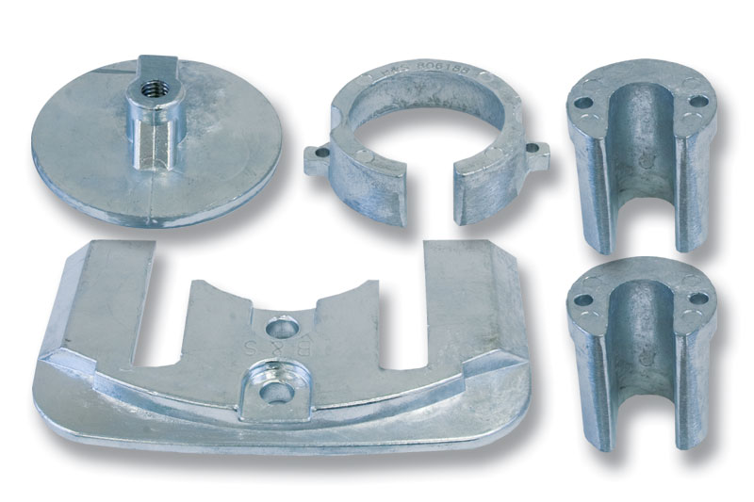
Sacrificial Anodes (Zincs)
Engine zincs
Exchange cooler
Transmission/oil cooler
Raw water intakes
Outdrive zincs
Actuator piston arms
Prop hubs
Lower unit foot/skag
Running gear
Prop shafts
Rudders
Trim tabs
Hull
Grounding buss
Near intakes and transponders

Slide 16
Air Conditioning Systems
Pump/draw antifreeze into air conditioner pump intake
Clean sea strainer and add antifreeze
Clean AC unit coils and drip pan
Clean air ducts and replace air filters
Shut of AC breakers at electrical panel

Slide 17
Heads / Waste Tank
Pour cleaning solution through heads and clean
Drain waste tank at pump-out
Lube waste tank deck fitting
Close head seacocks
Pump/draw antifreeze into head – run enough to fill the line to the waste water tank
Open waste tank seacock – Run macerator pump
Close waste tank seacock and remove handle or flag

Slide 18
Fresh Water System
Bypass valves
Fresh water tank
Hot water heater
Rinse and drain fresh water tank
Drain/replace fresh water filters
Drain hot water tank
Pump/draw antifreeze to all faucets
Head sink
Head shower
Galley sink
Aft deck sink
Ice maker
Transom shower

Slide 19
Bypass Valves
ANTIFREEZE
BUCKET
FILLER TUBE
TANK
BYPASS
LINE
WATER PUMP
ACCUMULATOR
CHECK VALVES
TANK VENT
IN-LINE FILTER
WATER TANK
WATER
HEATER
TANK BYPASS
COLD
HOT
TANK BYPASS
VALVE / DRAIN
SHORE WATER CONNECTION

Slide 20
Gray Water System
Bleach all drains
Antifreeze all sink/shower drains
Clean sump pumps – add antifreeze
Run antifreeze through anti-siphon loop
Turn sump pumps off at DC breaker panel
SINK
TRAP
Shower
Drain
ANTI-SIPHON
LOOP
SUMP
DISCHARGE
SUMP PUMP

Slide 21
Galley
Remove all perishable foods
Remove all unsealed food stores
Remove all items subject to freezing
Set refrigerator/ice maker temperature
setting to OFF
Clean/defrost refrigerator/ice maker
Prop door open
Drain appliance reservoirs or drip pans
Coffee pot
Refrigerator
Ice maker
Close propane gas lines (tank/stove)
Remove propane bottles from the boat.
Seal the end of the propane line.
Inspect propane lines for damage.

Slide 22
Sailboat
Sails and rigging
Inspect sails for ware and damage
Wash sails and running rigging; and store
Mast
Pull the mast, inspect mast boot, mast heel and fittings for corrosion
Check the crane and masthead sheaves for wear and stress cracks,
Inspect electrical wiring to the navigation and spreader lights
Inspect boom and rigging for wear and damage.
Remove tape from spreader tips and turnbuckles and inspect
Systems
Fog winches, mainsheet system, turning blocks and rope clutches
Remove all the running rigging and wash – Run a mouse to retrieve in the spring
Fog all exit boxes and turning blocks – inspect for wear and corrosion
Lube folding prop and steering linkage

Slide 23
Electrical / Electronic
Download nav files from GPS and Radar units
Take VHF/FRS handheld units home
Discharge hand-held spotlights
Fog all 12-volt accessory plug connectors
Fog battery terminals and winch connections
Fog navigation light connections
Turn off all battery switches * (Port / Starboard / Generator)
Turn off AC breaker in electrical panel
Fog shore power connectors
* Make sure your bilge pumps and water alarms are still directly powered

Slide 24
Bilge
Clean bilge pump filters
Pump antifreeze through bilge pumps
Pump water out of bilge - Clean and dry bilge
Set bilge heaters to “low” (if not off)
Check for items that might freeze
Place damp-away in bilge

Slide 25
Miscellaneous
Make sure deck scuppers are clear and open
Seal deck hatches for water intrusion
Pressure Wash Hull
Paint Hull Bottom and Running Gear
Fog engine spares
Dog all hatches/portholes
Open all interior lockers and drawers
Turn all cushions on edge
Lube canvas fasteners and zippers

Slide 26
Miscellaneous (Continued)
Waterproof canvas
Set canvas supports/restraints
Oil cabinets and wood surfaces
Place DampAway in cabin spaces
Place bow/deck cushions in cabin
Set anchor safety restraint
Check anchor locker for water/debris
Check all lockers for items that might freeze

Slide 27
Storage
Water storage
Better supported hull
Concern for snow loading pushing thru-hull fittings below the water
Water collecting in bilge through leaking deck hatches
Land storage
Better assess for maintenance
Boatel storage vs. open storage
Winter storage boat covers needed
Security concerns
On trailer
Easier to store – less expensive
Winter storage boat covers needed
Security concerns

Slide 28
Shrink Wrap
Advantages
Good tight, weatherproof seal
Keeps topsides and interior clean
No concerns with chafing or loose tarps
Optional vents and zippered doors prevent
mold and mildew
Far superior to bimini or regular canvas covers
Disadvantages
Cost runs $18 to $26 per foot – doors and vents are an extra expense
Cannot reuse the cover
Is not considered a particularly ‘green’ environmental solution
Limits access to the boat throughout the winter
Improperly vented cover and cause mildew problems
Potential gelcoat damage from improper use of heat guns

Slide 29
Dock Items – Leaving Boat in the Water
Set/secure bubbler in slip and test
Check mooring lines for tide swings
Set fenders for tide swings
Check slack loops in Power/TV cables and water line
Drain water hose and bring aboard
Check dock locker for items that might freeze

Slide 30
Final Check – Leaving Boat in the Water
"Ship-Shape" Inspection
Power on for bubbler
Check all seacocks are closed
Inspect all thru-hulls fittings
Double-check clamps on all thru-hull connections
Activate security alarm and test
Activate high-water alarm and test

Slide 31
Trailer and Dinghy
Fog all electrical connections and lamp sockets
Lube winch and rollers
Lube ball hitch and safety latch
Fill hydraulic reservoir
Check for rust or corrosion
Set axel on blocks
Deflate dinghy and oil wood flooring

Slide 32
100 Years of Service
1914 - 2014

